Slide 1
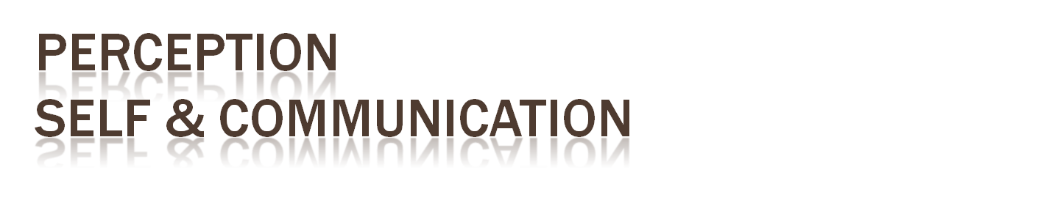
Kris Kego
Department of Construction Management
Sem 1; 2016-2017

Slide 2

This is communication through sending and receiving wordless cues
It includes the use of cues such as
  body language (kinesics)
  distance (proxemics)
  physical environments/appearance,
  Of voice (paralanguage)
  Of touch (haptics)
  Of time (chronemics)
  Of sight (oculesics)

Slide 3

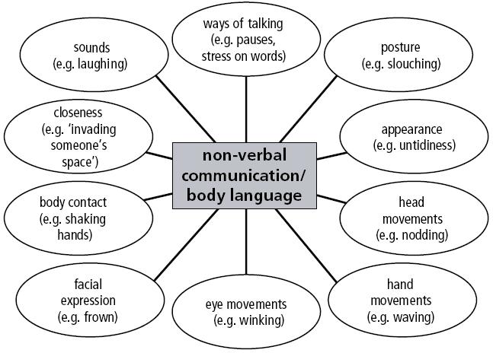

Slide 4

Perception is the organization, identification, and interpretation of sensory information in order to represent and understand the environment

Slide 5
Perception
  Process of becoming aware from senses
  Active Perception
  Subjective Perception
  Physiological factors
  Past experiences
  Culture and co-culture
  Present feelings and circumstances

Slide 6

How do we perceive?
  Selection
  Organization
  Interpretation

Slide 7

The Perceiver, the person who becomes aware about something and comes to a final understanding.
There are 3 factors that can influence his or her perceptions: experience, motivational state and finally emotional state.

Slide 8
The Target. This is the person who is being perceived or judged. "Ambiguity or lack of information about a target leads to a greater need for interpretation and addition."

Slide 9
The Situation also greatly influences perceptions because different situations may call for additional information about the target.

Slide 10

Perception errors
  Attribution errors
    Fundamental attribution error
    Self-serving bias
  Perceptual errors
    Stereotyping
    First impressions

Slide 11

Guidelines for Improving Perception
  Recognize that all perceptions are partial and subjective.
  Avoid mindreading.
  Check perceptions with others.
  Distinguish between facts and inferences.
  Guard against the self-serving bias.
  Guard against the fundamental attribution error.
  Monitor labels.

Slide 12

What do you know about yourself?
  Self-perception
  Personal identity
Who you are develops through
  Intrapersonal communication
  Symbolic interactionism
  Self-fulfilling prophecy

Slide 13

Learning More About Yourself
  Understand your physical self
  Understand how others perceive you
  Understand your communication skills and behaviors

Slide 14

What’s Your Future Potential?
  Self-actualization
  The fulfillment of one’s potential
How Do You Evaluate Yourself?
  Self-Appraisal/Self-Concept has two parts
  Self-Image
  Self-Esteem

Slide 15
Self-Image
The picture you have of yourself
Based on feedback from others
  Confirmation
  Rejection
  Disconfirmation

Slide 16
Self-Esteem
  How you feel about yourself
  Based on your perceptions of your successes and failures
  Affects perception and communication

Slide 17
Improving Self-Concept
  Have a goal or objective
  Make your goal realistic
  Find information about how to achieve your goal
  Exercise control and restraint
  Gain support of friends and family
  Accept yourself

Slide 18

How Do We Present Ourselves?
  Self-presentation
    The way we portray ourselves to others
  Identity Management
    Control (or lack of control) of the communication of information through a performance
    High and low self-monitors
    Face, facework, politeness

Slide 19

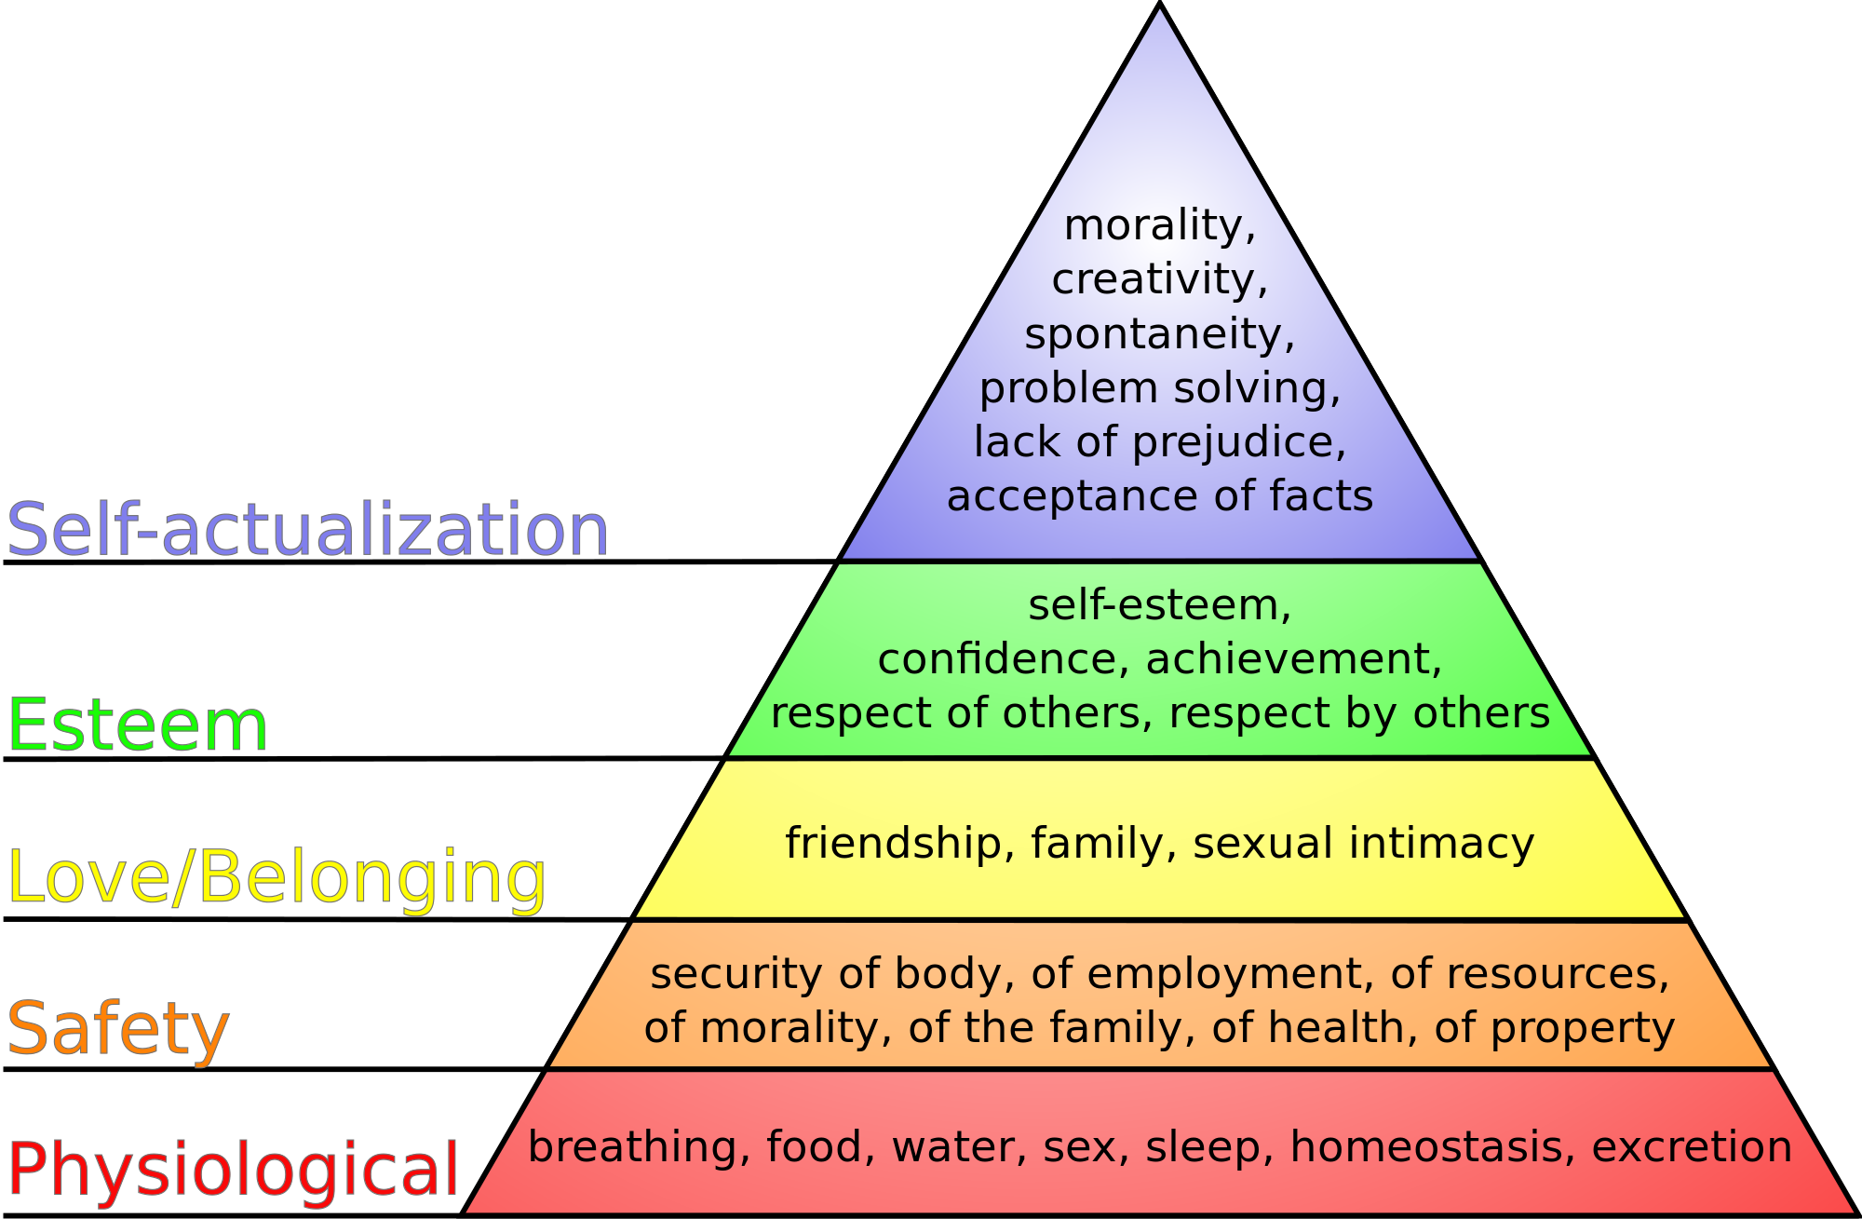

Slide 20

Goldstein, E. Bruce (13 February 2009a). Sensation and perception
Gregory, Richard L.; Zangwill, O. L. (1987). The Oxford companion to the mind
Gibson, J. J. (1966). The Senses Considered as Perceptual Systems.

